Slide 1
Heart Failure
Prepared By Nawaf Nasser Almutairi

Slide 2
CONTENTS OF THIS PRESENTATION
1
3
Intruduction
Data cleaning
2
4
Data structure
Data analysis

Slide 3

Overview Heart failure
Heart failure is when the heart is unable to pump blood around the body properly.
Causes of heart failure
coronary heart disease (high cholesterol)
high blood pressure
congenital heart disease
Sometimes anaemia or drinking too much alcohol.
The main symptoms of heart failure are:
Chest pain (angina)
breathlessness after activity or at rest
feeling tired most of the time and finding exercise exhausting
swollen ankles and legs
Notes:
t's sometimes called congestive heart failure, although this name is not widely used nowadays.
Heart failure does not mean your heart has stopped working. It just needs some support to help it work better.
It can occur at any age, but is most common in older people.
Heart failure is a long-term condition that tends to get gradually worse over time.
It cannot usually be cured, but the symptoms can often be controlled for many years.

Slide 4

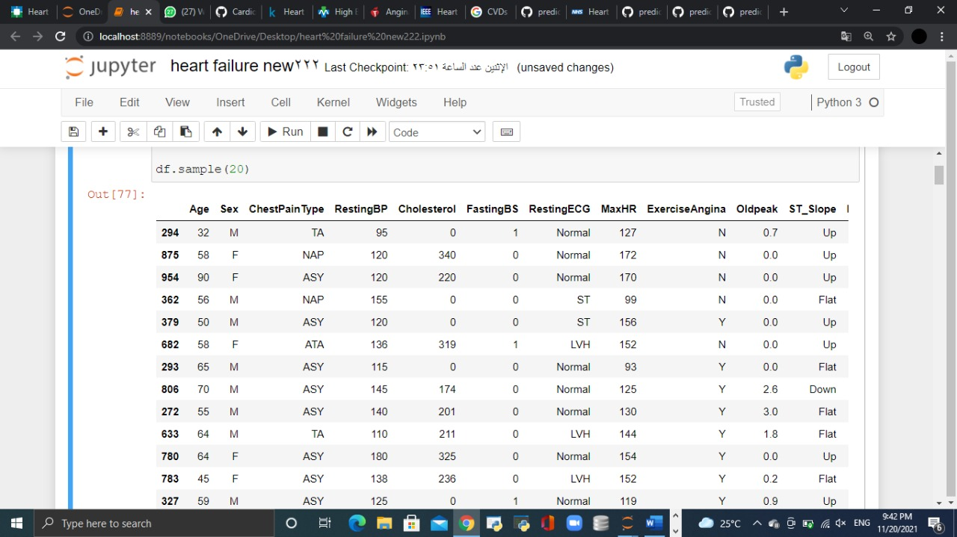
Data structure
Rows: 999
Columns: 12 columns such as:
Age: mean of 54 y
Sex: Male
Chest Pain Type: ASY (Asymptomatic)
Resting BP: mean of 132 /90
Cholesterol: Mean ?

Slide 5
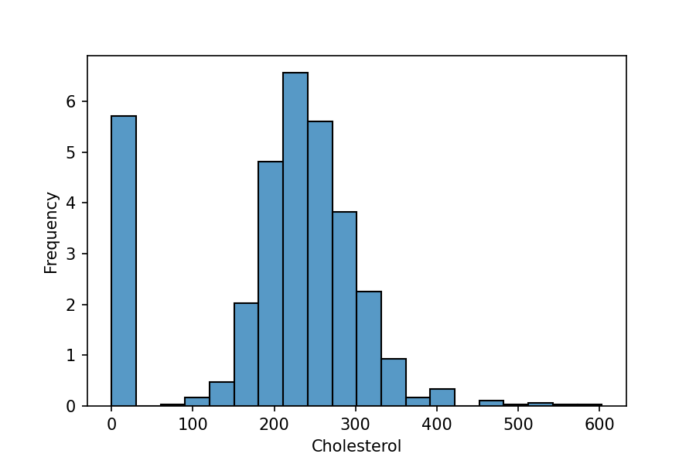
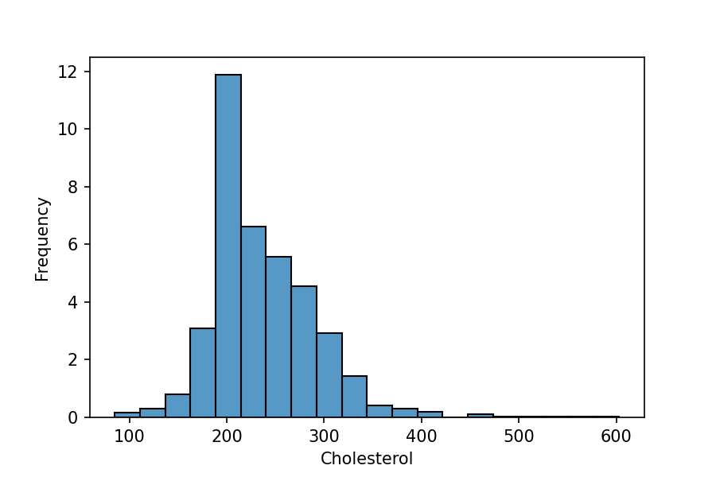
DATA CLEANING
What is the subsense for the value that contains zero ?
Mode ?
WRONG, because it is used for categorical values
Median ?
WRONG, because it is used for skewed distribution
Mean ?
Correct, because it is used for normal distribution

Slide 6
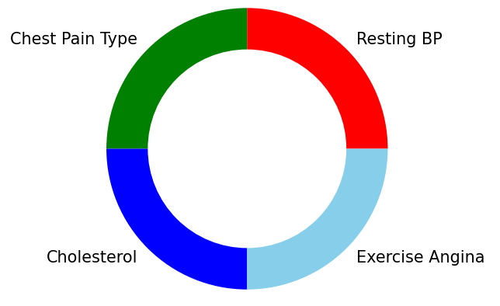
Data Analysis
In the analysis we will take four factors:
Chest pain type
Resting BP
Exercise angina
Cholesterol
The most patients with chest pain were facing ASA, Asymptomatic with number of 405.
The patients with hypertension (>140/90) and heart failure were 492.
The patients who have exercise angina were 337.
The patients who have high cholesterol and above were 529.

Slide 7
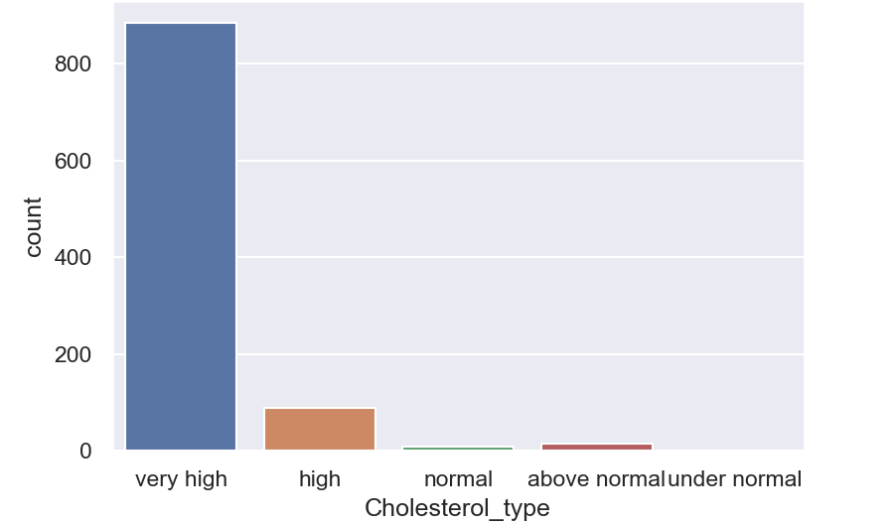
THE RESULT
This is a chart showing high cholesterol is the most common cause of the heart failure:

Slide 8
Conclusion
Heart failure is a serious long term condition that will usually continue to get slowly worse over time
It severely limit the activities you are able to do and is often eventually fatal.
It is very important to change your lifestyle to healthy diet to avoid the cholesterol which is the main cause leading to heart failure.
In the future, we aspire to minimize the occurrence of heart failure by prediction of the causes earlier.

